Slide 1
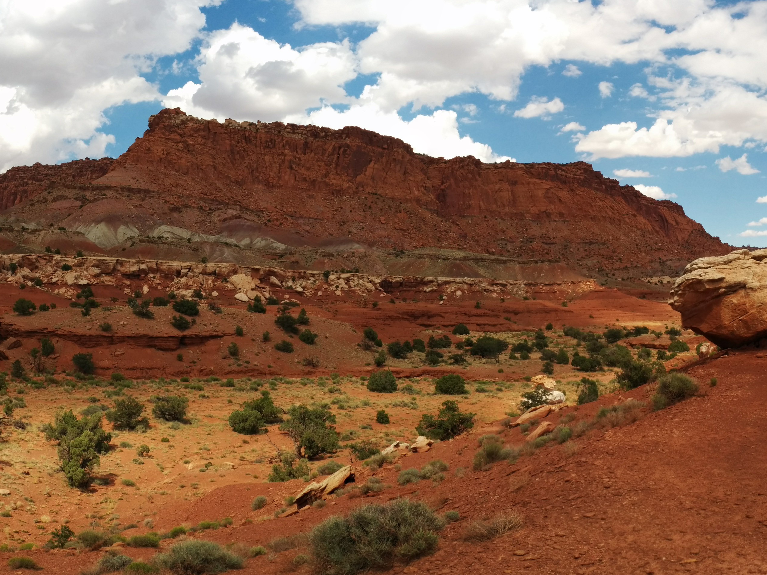
XYZ Strike Dip Calculator

Slide 2
What is it?
Takes XYZ input
Fits the best fit plane to the points
Measures strike, dip, and dip direction from the resulting plane

Slide 3
How is this useful?
Geologic mapping with satellite images
Seismic fault interpretations
Water table determination
I don’t know. Use your head and think of other applications. I’m not your mom.

Slide 4
Assumptions:
This calculator assumes the surface can be approximated by a linear plane. If it cannot, break up the segments of the surface that you believe are linear planes and insert them separately.
This calculator also assumes you have added in good data. Garbage in, garbage out as they say. I’ll be adding an r^2 value and 3D plotting capabilities in the future to check the accuracy of your results.

Slide 5
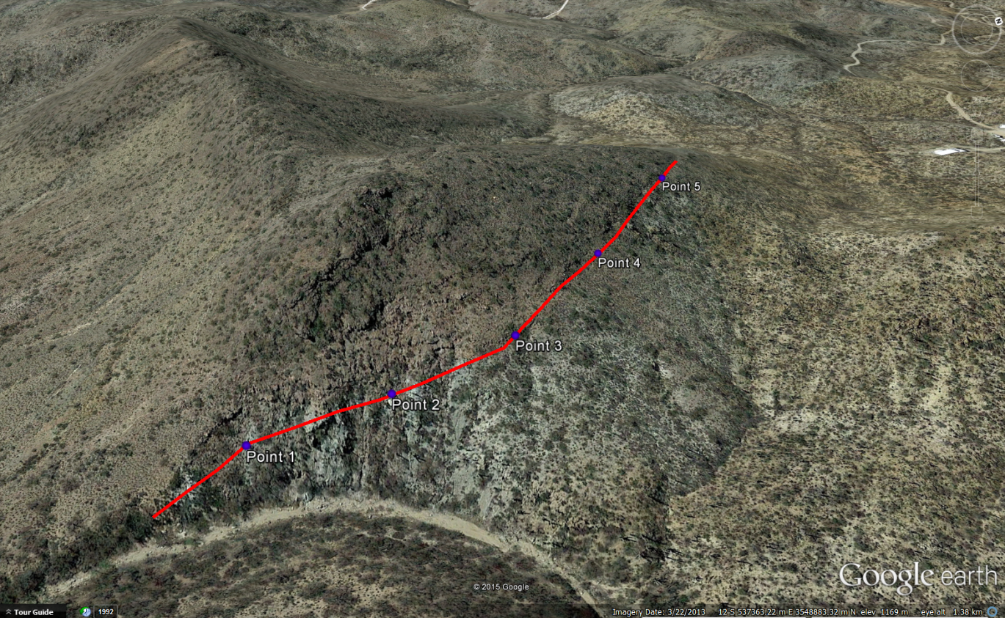
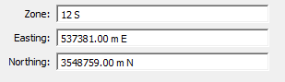
Example Use #1:
Mapping in Google Earth or other satellite imagery is a great way to supplement field mapping.
Strike and dip of faults can be determined by taking XYZ points of the fault exposure on the surface and plugging them into the calculator.
Note that Google Earth has very, very poor resolution when it comes to Z values. Probably better off using a DEM to get more accurate values, but Google Earth works for most class-based mapping projects.
X
Y
Fault
Z
*It’s important to note that Z decreases value with depth. So in this example, which is above sea level, Z would be positive. Seismic software often exports TVDSS values as positive, so make sure to check this!

Slide 6
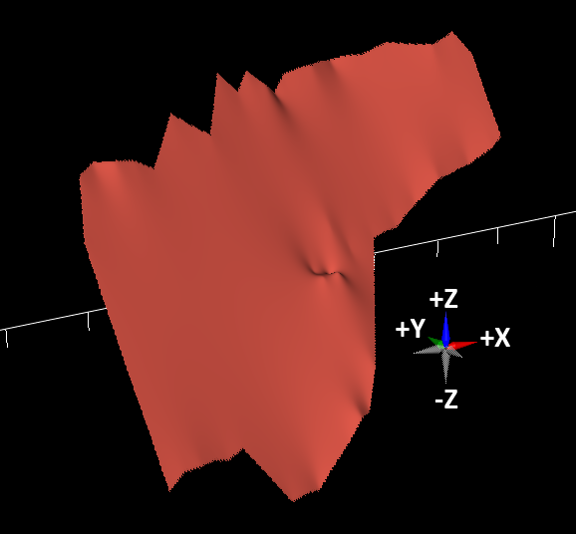
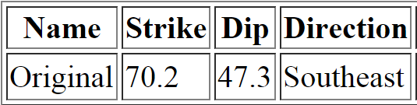
Example Use #2:
Input Data:
0 | 0 | 0 | Original
-1311 | 3484 | 4466 | Original
-1611 | 23 | 792 | Original
-2580 | 2598 | 4099 | Original
-1156 | 233 | 825 | Original
-2085 | 2703 | 3960 | Original
-1980 | -84 | 865 | Original
-3094 | 2445 | 4156 | Original
-2438 | -285 | 898 | Original
-3633 | 2427 | 4189 | Original
-2921 | -428 | 931 | Original
-4045 | 2123 | 4115 | Original
-3364 | -663 | 808 | Original
-4267 | 1387 | 3462 | Original
-273 | 3566 | 4115 | Original
932 | 362 | -65 | Original
366 | 4485 | 4736 | Original
2017 | 792 | 335 | Original
2479 | 983 | 555 | Original
909 | 4495 | 4474 | Original
2679 | 2987 | 2125 | Original
1861 | 4816 | 4452 | Original
2166 | 2908 | 2239 | Original
1312 | 4818 | 4680 | Original
2298 | 2613 | 2182 | Original
2888 | 1295 | 557 | Original
2786 | 2748 | 2190 | Original
3268 | 1668 | 1014 | Original
2246 | 5139 | 4313 | Original
2997 | 3525 | 2647 | Original
2663 | 5428 | 4485 | Original
3556 | 3509 | 2329 | Original
3633 | 5712 | 4517 | Original
4490 | 3873 | 2321 | Original
4484 | 6237 | 4493 | Original
5422 | 4257 | 2329 | Original
5527 | 6370 | 4476 | Original
6311 | 4717 | 2517 | Original
7274 | 5019 | 2754 | Original
6501 | 6651 | 4582 | Original
8663 | 5591 | 2794 | Original
8103 | 6773 | 4436 | Original
9647 | 5849 | 2925 | Original
9034 | 7143 | 4542 | Original
10104 | 6054 | 3039 | Original
9656 | 6999 | 4182 | Original
After exporting a fault data from seismic, edit the ASCII output to be X, Y, Z, faultname.
Note the Z value should decrease with depth. For example, if this fault were 20,000 ft below sea level, the Z value should be -20000.
Also note the input data was all referenced to the original point. This is not necessary.
Fault Plane
Output Data:

Slide 7
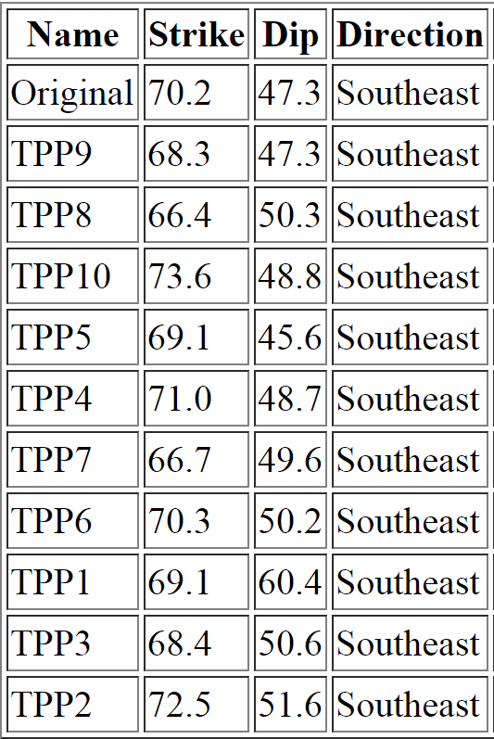
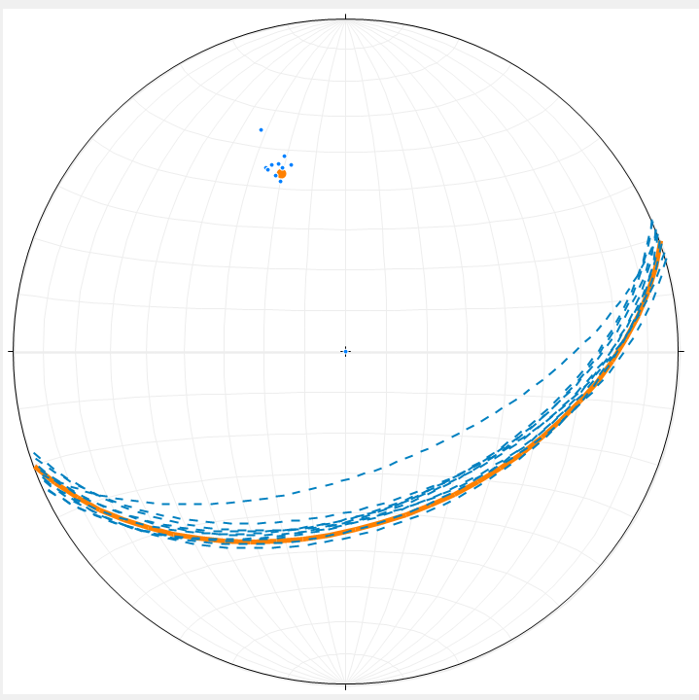
Accuracy:
Input Data:
0 | 0 | 0 | Original
-1311 | 3484 | 4466 | Original
-1611 | 23 | 792 | Original
-2580 | 2598 | 4099 | Original
-1156 | 233 | 825 | Original
-2085 | 2703 | 3960 | Original
-1980 | -84 | 865 | Original
-3094 | 2445 | 4156 | Original
-2438 | -285 | 898 | Original
-3633 | 2427 | 4189 | Original
-2921 | -428 | 931 | Original
-4045 | 2123 | 4115 | Original
-3364 | -663 | 808 | Original
-4267 | 1387 | 3462 | Original
-273 | 3566 | 4115 | Original
932 | 362 | -65 | Original
366 | 4485 | 4736 | Original
2017 | 792 | 335 | Original
2479 | 983 | 555 | Original
909 | 4495 | 4474 | Original
2679 | 2987 | 2125 | Original
1861 | 4816 | 4452 | Original
2166 | 2908 | 2239 | Original
1312 | 4818 | 4680 | Original
2298 | 2613 | 2182 | Original
2888 | 1295 | 557 | Original
2786 | 2748 | 2190 | Original
3268 | 1668 | 1014 | Original
2246 | 5139 | 4313 | Original
2997 | 3525 | 2647 | Original
2663 | 5428 | 4485 | Original
3556 | 3509 | 2329 | Original
3633 | 5712 | 4517 | Original
4490 | 3873 | 2321 | Original
4484 | 6237 | 4493 | Original
5422 | 4257 | 2329 | Original
5527 | 6370 | 4476 | Original
6311 | 4717 | 2517 | Original
7274 | 5019 | 2754 | Original
6501 | 6651 | 4582 | Original
8663 | 5591 | 2794 | Original
8103 | 6773 | 4436 | Original
9647 | 5849 | 2925 | Original
9034 | 7143 | 4542 | Original
10104 | 6054 | 3039 | Original
9656 | 6999 | 4182 | Original
Taking three random points from the original input data and performing a three point problem (TPP) on them yields similar results, but can be off by 13° or more in this case. The best fit plane method yields more accurate results.
Fault Plane
N
Data plotted using Rick Allmendinger’s Stereonet 9. Orange is original data using best fit plane method, blue is 10 iterations of three point problems.
W
E
S

Slide 8

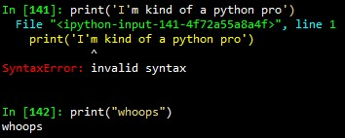
Acknowledgements:
This program was created as a response to:
Being annoyed that this didn’t already exist
Wanting to learn to program. This is my first program. Cut me some slack.
Thanks to Phillip McFarland for his mathematical explanations and Matthew Lenz for all his programming support and putting up with my stupidity.
Noah McDougall
Creator of this program and bad motivational posters
If you’ve got any questions or suggestions, shoot me an email at noahmcdougall@email.arizona.edu

